Slide 1
Karen Lee
Distinguished Fulbright Award in Teaching Recipient

Slide 2
Thurgood Marshall Academy Public Charter School
Located in southeast, Washington DC
Has 390 students grades 9-12 (ages 14-19)
Primarily enrolls students from Wards 7 and 8
Lowest income
Poorest performing schools
Highest unemployment rate
Highest high school drop out rate

Slide 3
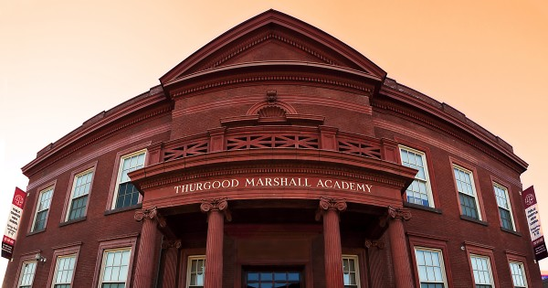
Ranked the highest performing open enrollment school in DC
Charter School started in 2001
100% of our students are accepted into college
80.5% enroll right after graduation
74% remain in college
Very successful academic program

Slide 4
Vocational Education in DC
Not in a formal school setting
Can attend if dropped out of public schools
Usually 6-9 week program cycles
Only a few out of state year long programs
Run by non-profits and often not seen as a successful path to employment
Perceived as a last resort

Slide 5
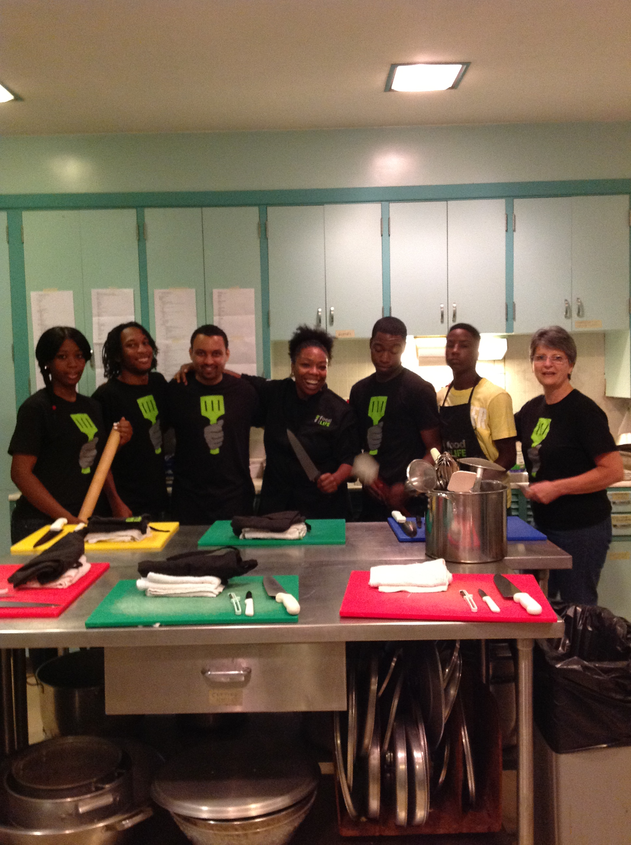
New Opportunities
DC is open to starting
new programs
Greed Club- horticulture training and green
initiatives
Food For Life- culinary arts training
combined with life skills lessons for out-of
school youth
Still seen as something you
do when you fail at traditional
school
Change the perception

Slide 6
State to State Differences
Not all states are like DC
Education is a state issue so each state offers different opportunities
Massachusetts leading state with vocational education
South Sore Vocational Technical High School
About 50% go directly into workforce after training
Military or more training
50 regional or comprehensive schools that offer vocational education
Very similar to your Finnish system combining training with academic classes
Educational opportunities aren’t equal

Slide 7
My Project
Compare Finland’s vocational schools and general upper secondary schools
What are the curricular differences between the two tracks?
Do students on both tracks learn the critical thinking, literacy and civic awareness skills needed to be successful in society?
Talk to students and teachers about decision to attend school and opportunities after completion
Take my information back to TMA to change the conversation about vocational schools

Slide 8
Thank you!
lee.karenjean@gmail.com
Office 309

